Slide 1
Exercise
How many moles of Al³⁺ and SO₄²⁻ does 1 mole of Al₂(SO₄)₃ contains? How many moles of S and O do 3 moles of Al₂(SO₄)₃ contain?
You want to make a 20 mM solution of hydroxide (OH⁻) in a 500 mL flask using barium hydroxide (Ba(OH)₂) salt. What mass of Ba(OH)₂ do you need to add?
What is the molality of 2025 μM of DIC in seawater if the density of seawater is 1027 kg/m³?
One plankton cell can transport 10 picograms (pg) of nitrogen (N) per second. How many μmols of N can 1 million plankton cells transport in a second? How many moles of N can 1 million plankton transport in 1 year?
You have a 2 mM solution of K₃PO₄. You want to make a 30 μM PO₄³⁻ solution in a 100 mL flask by dilution with water. What volume of K₃PO₄ is required?

Slide 2
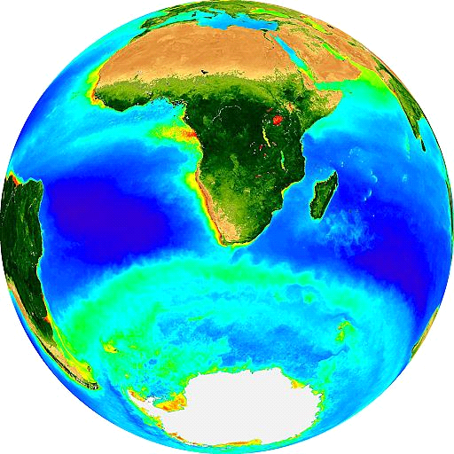
Marine Carbon Cycle
Sarah Fawcett
sarah.fawcett@uct.ac.za
Katye Altieri
24 May 2017

Slide 3
Biogeochemical cycles
Transport and transformation of chemical elements through the biotic (living) and abiotic (non-living) compartments of the Earth - return to the starting point after a series of changes (can be repeated).
Reservoir: “pool” in which chemical accumulates for a period of time (e.g., ocean, organic biomass)
Flux: transformation (movement) of a chemical from one reservoir to another

Slide 4
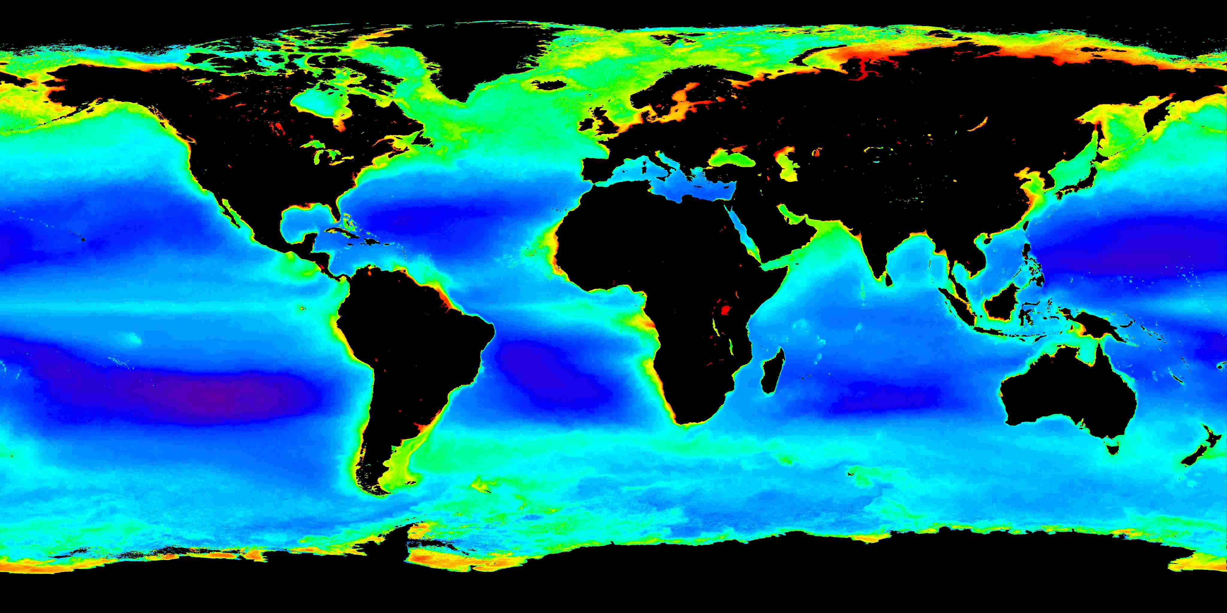
Understanding ocean fertility and climate
Chlorophyll-based: Annual composite ocean colour satellite image (SeaWiFs)

Slide 5
The global carbon cycle

Slide 6
The ocean dominates the carbon cycle
atmosphere = 2%
biosphere = 5%
ocean = 93%

Slide 7
CO₂ is highly soluble in seawater
Concentration of CO₂ in seawater is low
CO₂ + H₂O ↔ H₂CO₃ ↔ HCO₃⁻ + H⁺ ↔ CO₃²⁻ + H⁺
Conversion to ionic forms decreases oceanic CO₂ and more atmospheric CO₂ can be dissolved

Slide 8
CO₂ is highly soluble in seawater
Concentration of CO₂ in seawater is low
CO₂ + H₂O ↔ H₂CO₃ ↔ HCO₃⁻ + H⁺ ↔ CO₃²⁻ + H⁺
Conversion to ionic forms decreases oceanic CO₂ and more atmospheric CO₂ can be dissolved
For every 20 molecules of CO₂ absorbed by the ocean,
19 are rapidly converted to HCO₃⁻ and CO₃²⁻

Slide 9
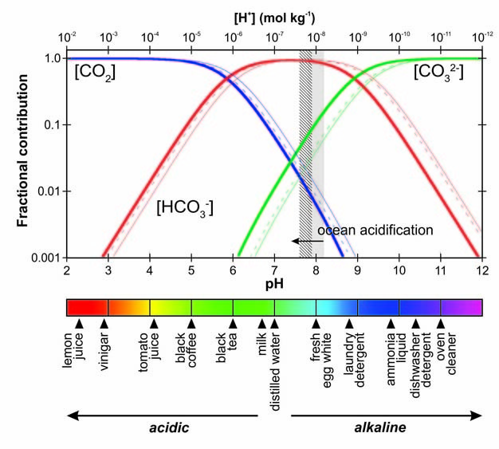
Bjerrum plot
Barker and Ridgewell, 2012

Slide 10
CO₂ is highly soluble in seawater
Concentration of CO₂ in seawater is low
CO₂ + H₂O ↔ H₂CO₃ ↔ HCO₃⁻ + H⁺ ↔ CO₃²⁻ + H⁺
Conversion to ionic forms decreases oceanic CO₂ and more atmospheric CO₂ can be dissolved
For every 20 molecules of CO₂ absorbed by the ocean,
19 are rapidly converted to HCO₃⁻ and CO₃²⁻
Carbonate equilibrium: reactions provide a chemical buffer, maintain ocean pH within a narrow range, and constrain the amount of atmospheric CO₂ the ocean can absorb

Slide 11
CO₂ is highly soluble in seawater
Concentration of CO₂ in seawater is low
CO₂ + H₂O ↔ H₂CO₃ ↔ HCO₃⁻ + H⁺ ↔ CO₃²⁻ + H⁺
Conversion to ionic forms decreases oceanic CO₂ and more atmospheric CO₂ can be dissolved
For every 20 molecules of CO₂ absorbed by the ocean,
19 are rapidly converted to HCO₃⁻ and CO₃²⁻
Carbonate equilibrium: reactions provide a chemical buffer, maintain ocean pH within a narrow range, and constrain the amount of atmospheric CO₂ the ocean can absorb
DIC = CO₂ + HCO₃⁻ + CO₃²⁻
Dissolved inorganic carbon = CO₂ + bicarbonate + carbonate

Slide 12
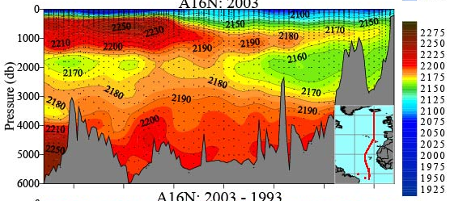
Surface-to-deep ocean DIC gradient
[DIC]
(μmol kg⁻¹)
DIC = CO₂ + HCO₃⁻ + CO₃²⁻
Dissolved inorganic carbon = CO₂ + bicarbonate + carbonate
Feely et al. 2001

Slide 13
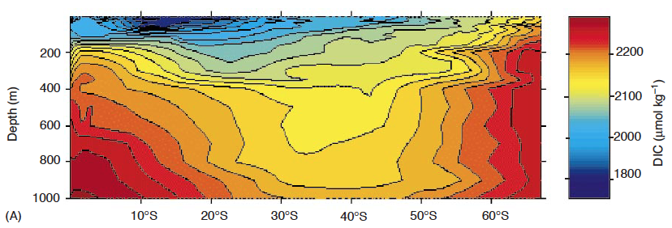
DIC in the upper 1000 m
equator
pole
DIC = CO₂ + HCO₃⁻ + CO₃²⁻
Dissolved inorganic carbon = CO₂ + bicarbonate + carbonate

Slide 14
Surface-to-deep ocean CO₂ gradient

Slide 15
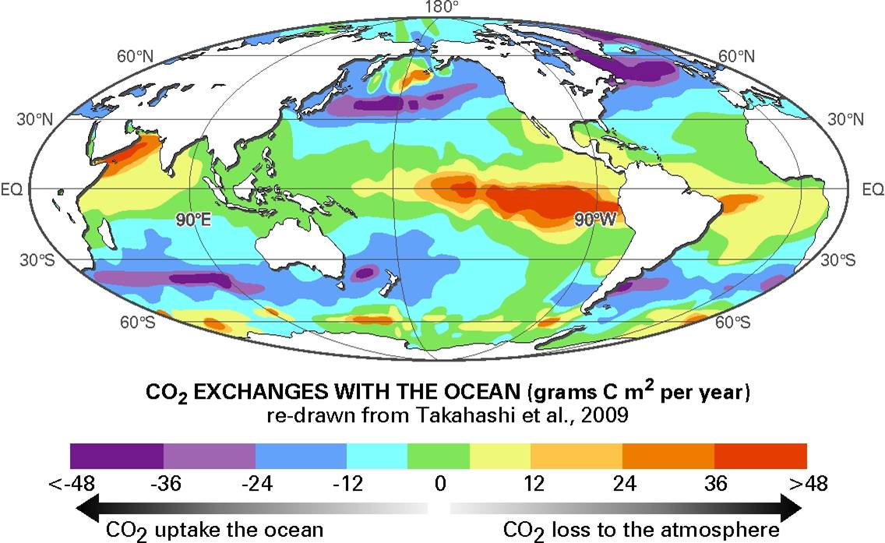
Atmosphere-ocean CO₂ fluxes (ΔpCO₂)

Slide 16
Controls on CO₂ fluxes: Solubility pump
The physico-chemical process that transports dissolved inorganic carbon (DIC) from the surface ocean into the ocean interior. This helps to maintain the vertical gradient of dissolved inorganic carbon (DIC) in the ocean, in net causing the storage of CO₂ in deep waters and thus lowering atmospheric CO₂.
The solubility pump is driven by: (1) the solubility of CO₂ in the ocean, with more CO₂ dissolving at colder seawater temperatures, and (2) thermohaline circulation, which involves deep water formation at high latitudes where seawater is colder and denser.

Slide 17
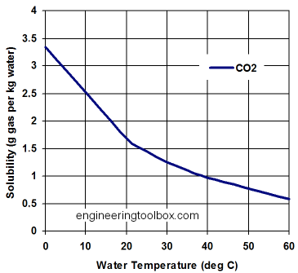
Solubility pump: temperature
As with other gases, CO₂ dissolves in water
More CO₂ dissolves at colder temperatures

Slide 18
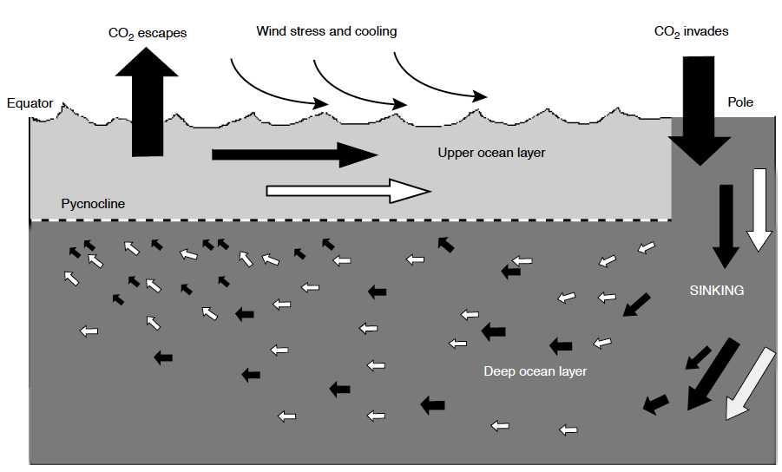
Solubility pump: thermohaline circulation
Carlson et al. 2009

Slide 19
Atmosphere-ocean CO₂ fluxes (ΔpCO₂)

Slide 20
Controls on CO₂ fluxes: Biological pump
The photosynthetic production, sinking, and deep ocean decomposition of organic matter that cause a vertical gradient of dissolved inorganic carbon (DIC) in the ocean, in net causing the storage of CO₂ in deep waters and thus lowering atmospheric CO₂.
In some cases, the biological pump is taken to involve two components: (1) the rain of soft tissue organic carbon from the surface to depth, the “soft tissue pump”, and (2) the rain of mineral calcium carbonate from the surface to depth, the “carbonate pump”. The former (1) lowers atmospheric CO₂, while the latter (2) raises it.

Slide 21
Photosynthesis
6CO₂ + 6H₂O C₆H₁₂O₆ + 6 O₂
C₆H₁₂O₆ + 6O₂ energy + 6CO₂ + 6H₂O
Respiration

Slide 22
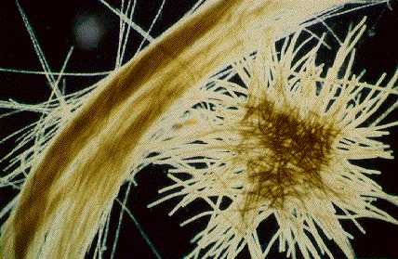
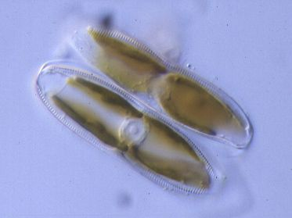
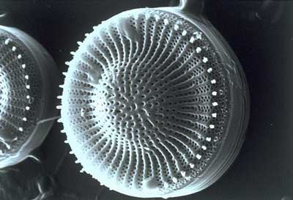
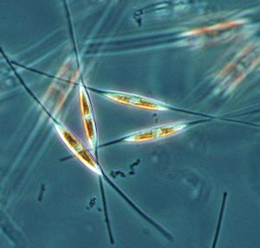
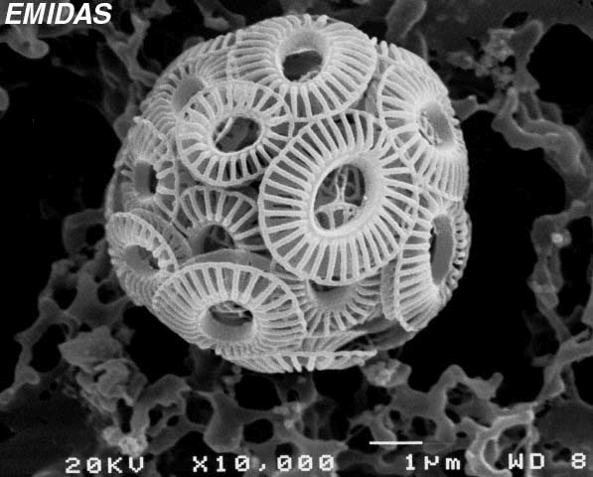
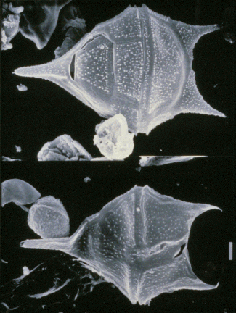
Phytoplankton: drivers of the biological pump

Slide 23
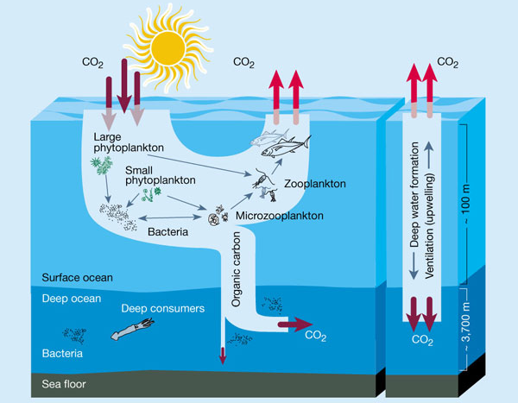
Biological pump: soft tissue pump
solubility pump

Slide 24
Most organic carbon is remineralized
net CO₂ consumption
euphotic zone = photosynthesis
twilight zone = intense respiration
net CO₂ production
respiration

Slide 25
Most organic carbon is remineralized
net CO₂ consumption
euphotic zone = photosynthesis
twilight zone = intense respiration
export
net CO₂ production
maximum depth
winter mixing
respiration
sequestration

